Slide 1
NIH Chest X-rays Classification
By Yu Xiao

Slide 2
Dataset
112,120 X-ray images with disease labels from 30,805 unique patients
14 pathology classes + 1 ‘No Finding’
Train dataset (86512) and test dataset (25592) with no overlapped patients
Data_Entry_2017.csv
Only used: ‘Image Index’, ‘Finding Labels’

Slide 3
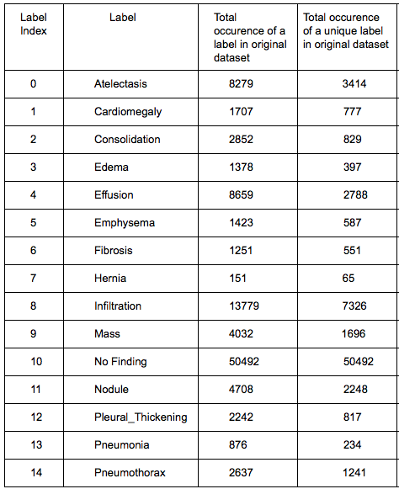
Data Distribution
Challenge
Imbalanced Nature
Dominating Classes:
‘No Finding’ (53.8%), ‘Infiltration’(17.7%),
‘Effusion’ (7.7%)
Under-represented Classes:
‘Hernia’ (0.2%), ‘Pneumonia’(1.2%),
’Fibrosis’(1.5%)
Label Dependency
Multi-label (18.5%)

Slide 4
Workflow
Clean Data; Images to Numpy Array
Train with Data Augmentation
Preprocessing
Pre-trained Model
More Layers
Training
Evaluation
Feature Selector
AUROC Scores; Confusion Matrix

Slide 5
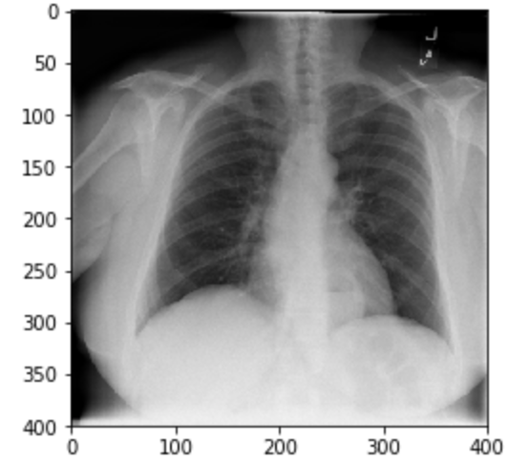
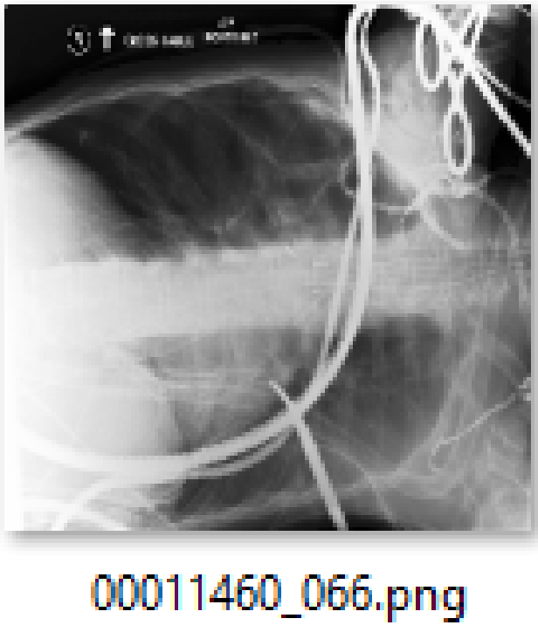
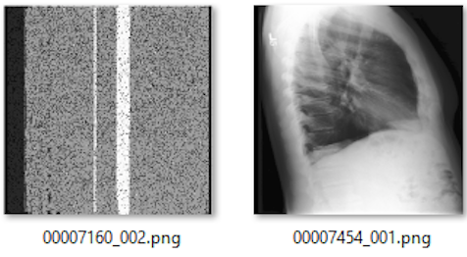
Preprocessing - Remove Blacklist
Remove images with poor quality, rotation and different view point in the dataset. A blacklist of these images are provided on AzureChestXRay github.
Normal image:
Blacklist images:

Slide 6
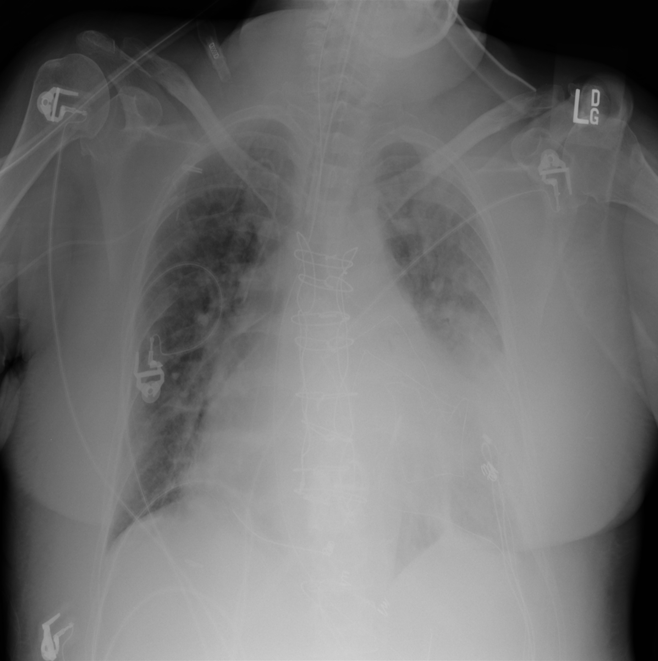
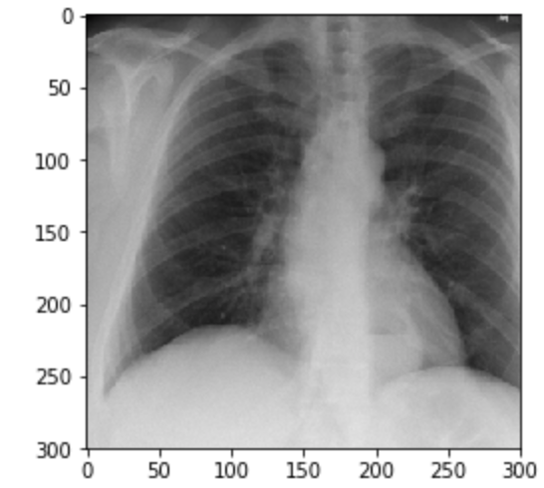
Preprocessing - Crop
Second, we cropped and save the center 75% images to better focus on the lung area. This will remove clavicles, top of vertebral column, medical wires, and some writing on original images.

Slide 7
Preprocessing - Image Size
Third, we loaded image as size 300*300 for better accuracy. Large image dimensions are expected to give more details despite longer training time.
Trade off: time

Slide 8
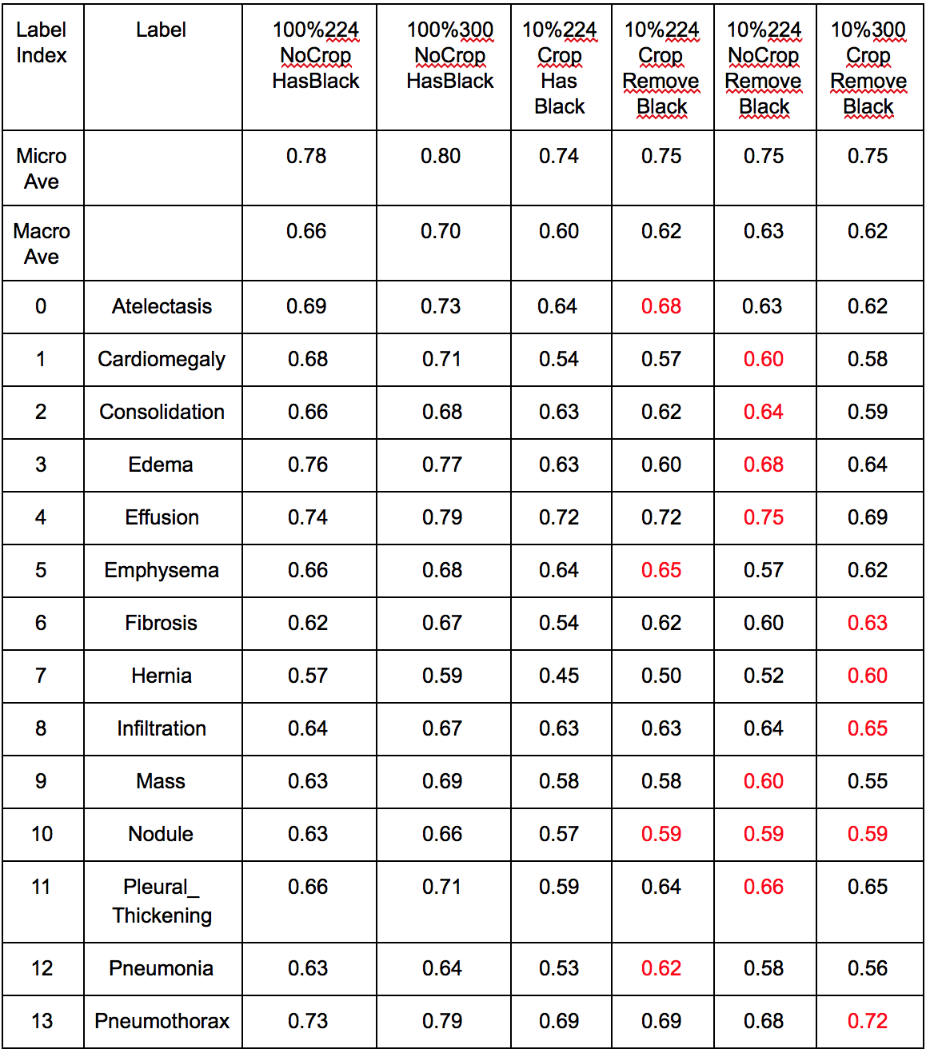
Experiment Result
Loading size : Column 3 and 4
BlackList : Column 5 and 6
Crop : Column 7 and 8

Slide 9
Stanford CheXNet Model
Label Strategy
Model & Setting
A vector of binary labels indicating the absence or presence of each of the 14 pathology classes
Example:
Finding Labels:
'Atelectasis', 'Consolidation'
[1,0,1,0,0,0,0,0,0,0,0,0,0,0]
Finding Labels: ‘No Finding’
[0,0,0,0,0,0,0,0,0,0,0,0,0,0]
DenseNet 121 (improve flow of information and gradients through the network, making the optimization of very deep networks tractable)
Replace final fully connected layer with one that has a single output, after which apply a sigmoid nonlinearity.
Weight: ImageNet
Loss function: unweighted binary cross entropy losses
Optimizer: Adam with standard parameters (β1 = 0.9 and β2 = 0.999)

Slide 10
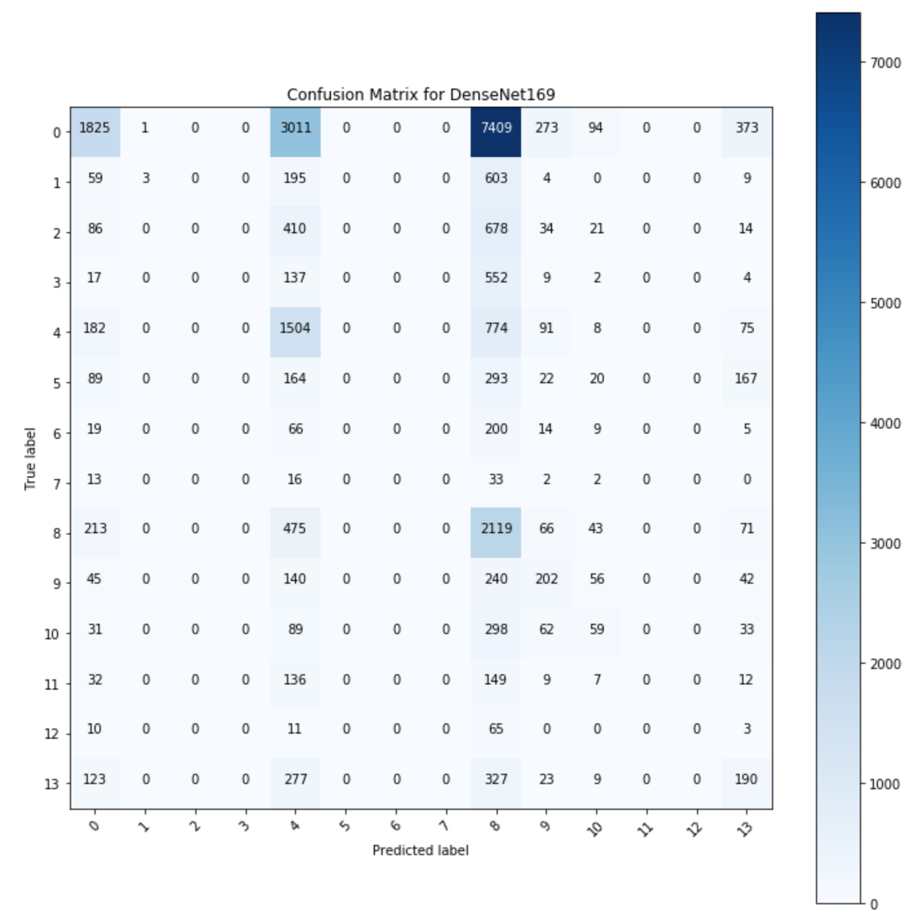
Evaluation Matrix
AUROC (Area under ROC curve):
Plot the true positive rate (recall) against the false positive rate (false alarm) at various threshold settings.
Insensitive to class distribution
AUC is equal to the probability of ranking a random positive example over a random negative example.
Confusion Matrix (Multi-Class)

Slide 11
CheXNet Underlying Problems
Lack of consideration in the imbalance nature of the dataset resulted the poor generalization ability of the CheXNet model. The model could barely identify samples from small classes.
Example: ‘Hernia’ vs. ‘Infiltration’
Could not identify the probability of the ‘No Finding’ class

Slide 12
Classification Type
Binary Classification
Multi-label Classification
Multi-class classification
Classify whether a patient has any diseases or no disease.
Classify images to 15 classes (14 pathology classes + 1 ‘No Finding’)
Classify images to 14 pathology classes (CheXNet approach)
Duplicate images with multi-label and associate each with single label.

Slide 13
Multi-label Classification - Fine-Tuning
Fine-tuning factors
Model type
Fully connected layer
Optimizer
Evaluation Metric
Lower loss value
Higher AUROC scores

Slide 14
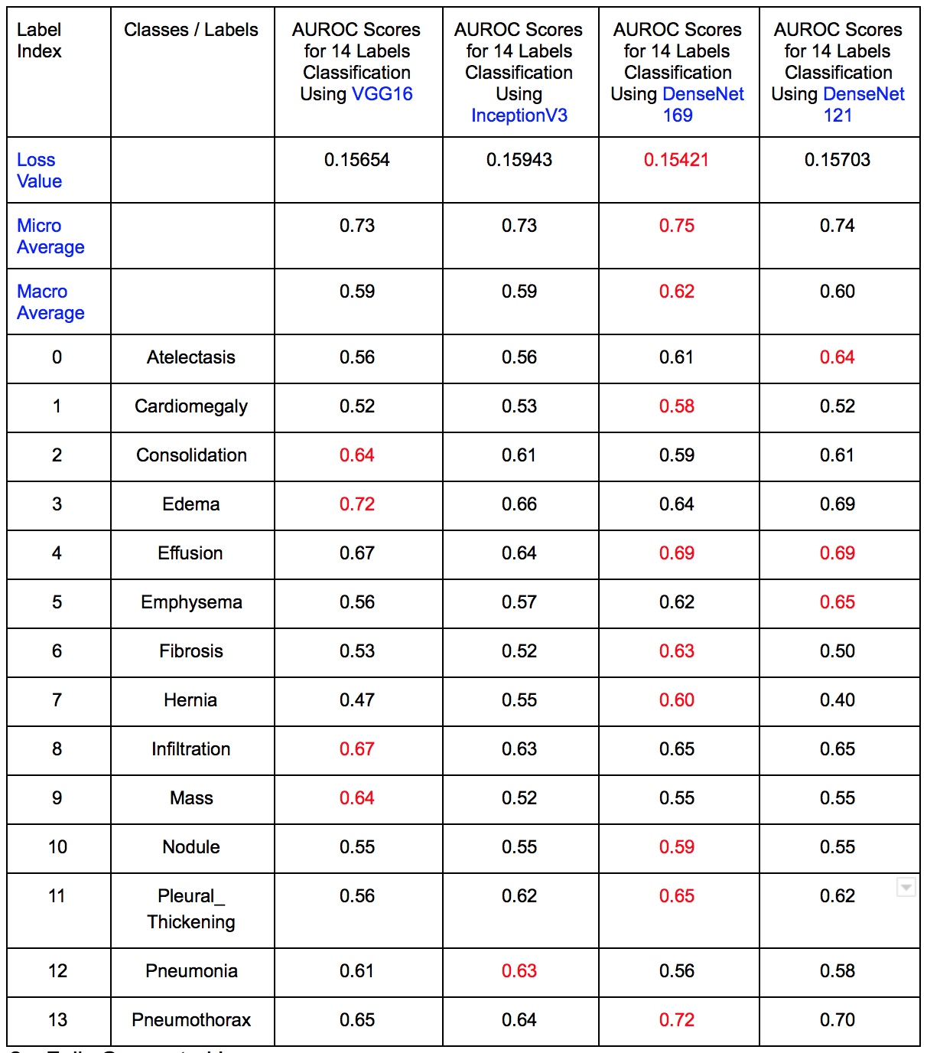
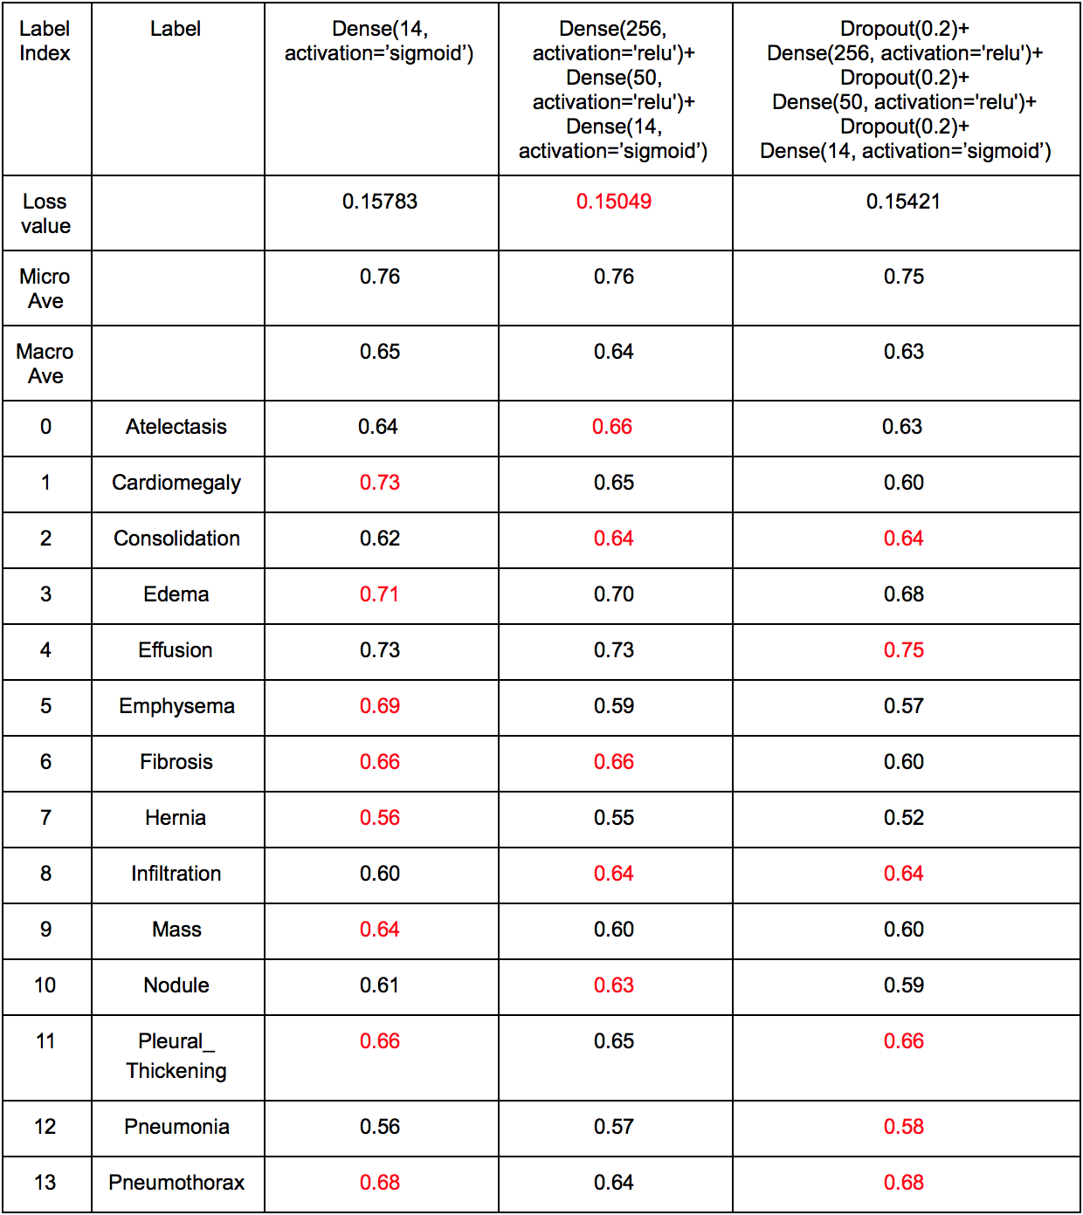
Fine-tuning - Model Selection & Fully Connected Layers

Slide 15
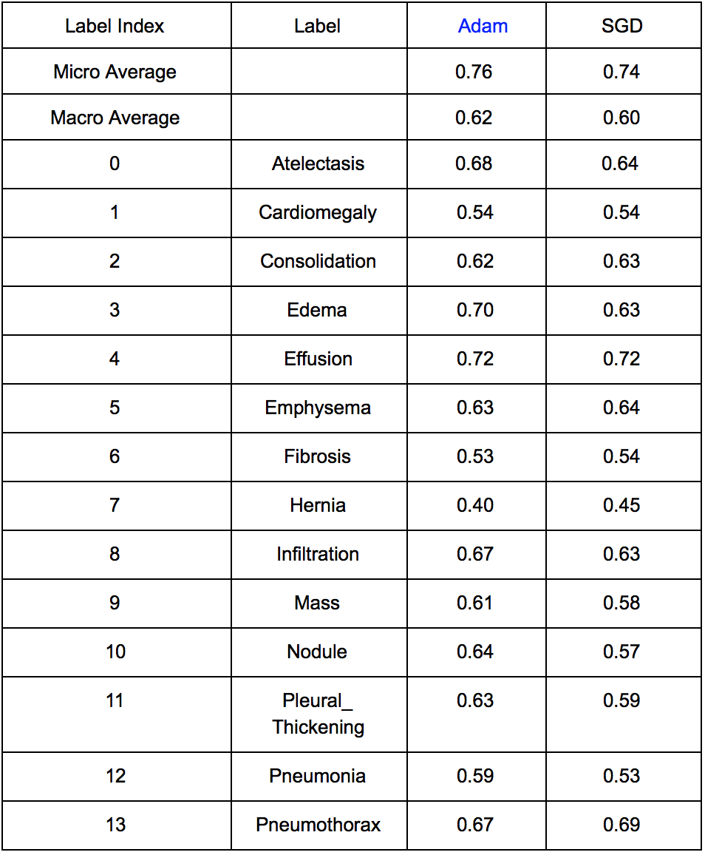
Fine-tuning - Optimizer
Adam: faster convergence rate
SGD: jump to local minima
Combine the strength

Slide 16
Final Model
Model | Loss function + activation | Optimizer | Fully Connected Layer | Weight
DenseNet 169 | binary_crossentropy + sigmoid | Adam + SGD | Dropout(0.1)+ Dense(256, activation='relu')+ Dropout(0.1)+ Dense(50, activation='relu')+ Dropout(0.1)+ Dense(14, activation=’sigmoid’) | ImageNet

Slide 17
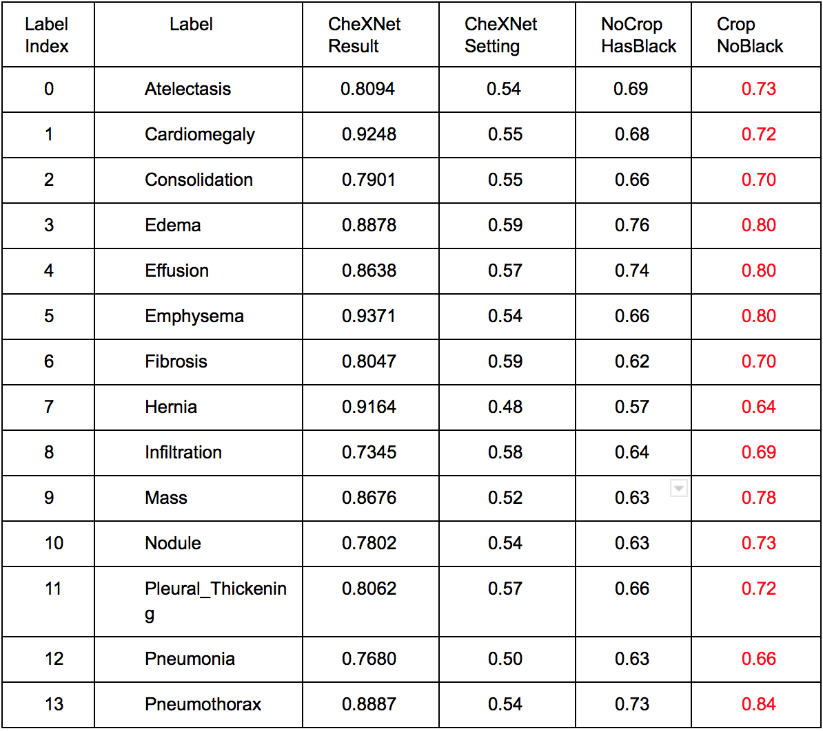
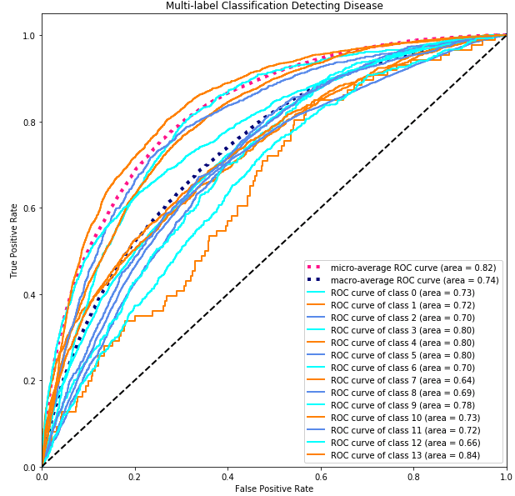
Classification Result (14 classes)
ROC Curve:

Slide 18
Classification Result
No prediction for Class 1,2,3,5,6,7,11,12
Negative interaction between dominated classes

Slide 19
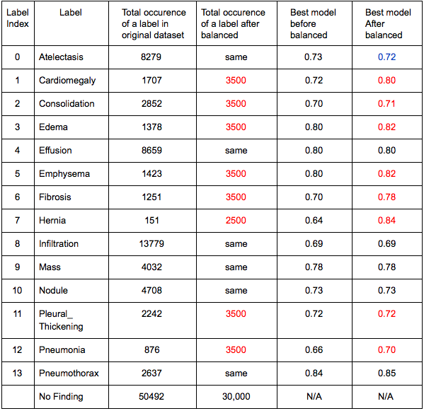
Classification Result on Balanced Dataset
AUROC scores were boosted as we enlarged the samples. (e.g. ‘Hernia’)
larger samples enabled will improve model’s classification ability quickly for under-represent class
Test dataset is imbalanced. Improvement for under-represent classes is more obviously.

Slide 20
Binary Classification on Fibrosis
Size:
1241 samples contained the label ‘Fibrosis’ in the train dataset and 431 samples contained the label ‘Fibrosis’ in the test dataset.
Label:
Fix ‘Fibrosis’ the class 0 and the rest of labels as class 1.
Dataset:
Filter out all ‘Fibrosis’ samples and mix with equal size of random samples from other classes as the train dataset. Same test dataset.

Slide 21
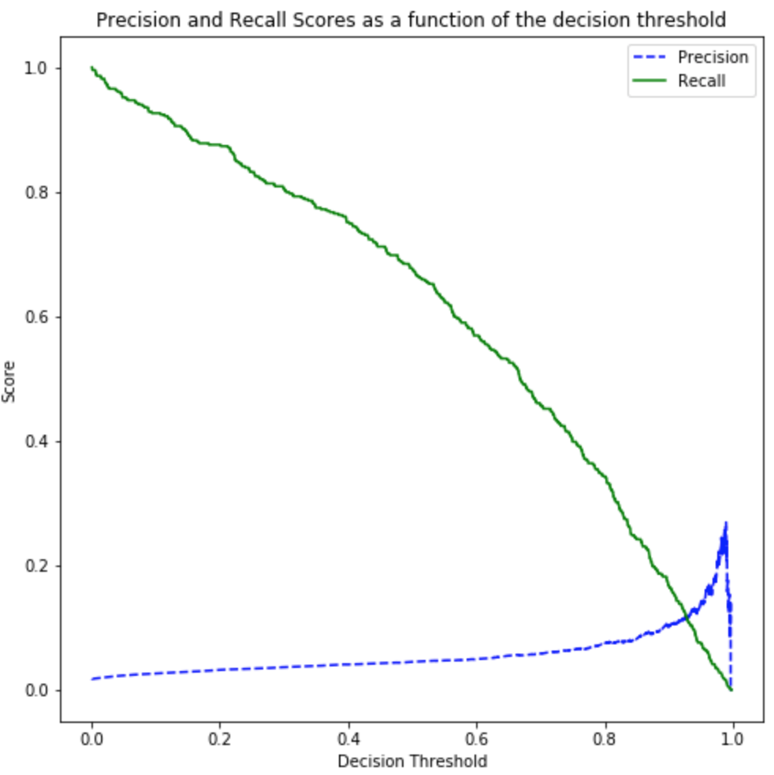
Binary Classification Result
Confusion Matrix at threshold 0.91 :
 | Pred_neg | Pred_pos
Neg | 23781 | 1043
Pos | 334 | 100
The lack of ‘Fibrosis’ samples boosted accuracy
Accuracy | Precision | Recall | F1-score | AUROC
0.9640 | 0.1073 | 0.1498 | 0.125 | 0.79
Improvement on balanced dataset?

Slide 22
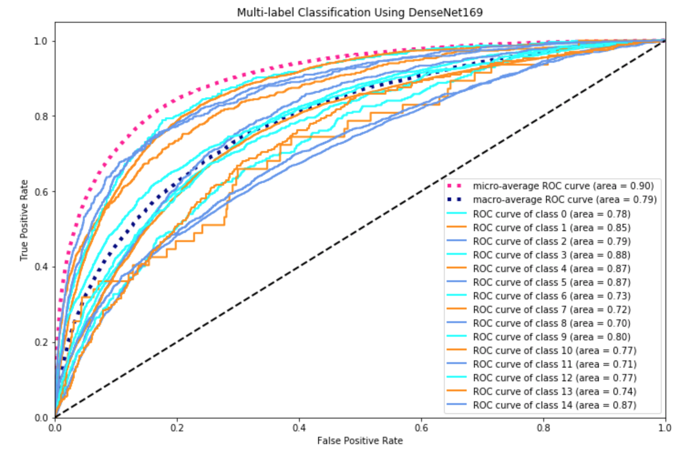
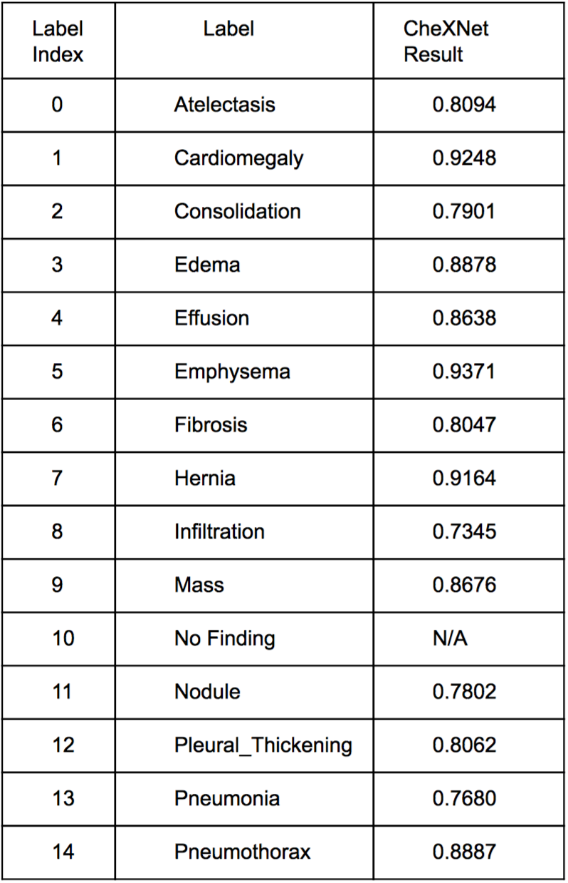
Multi-label Classification Result (15 Classes)

Slide 23
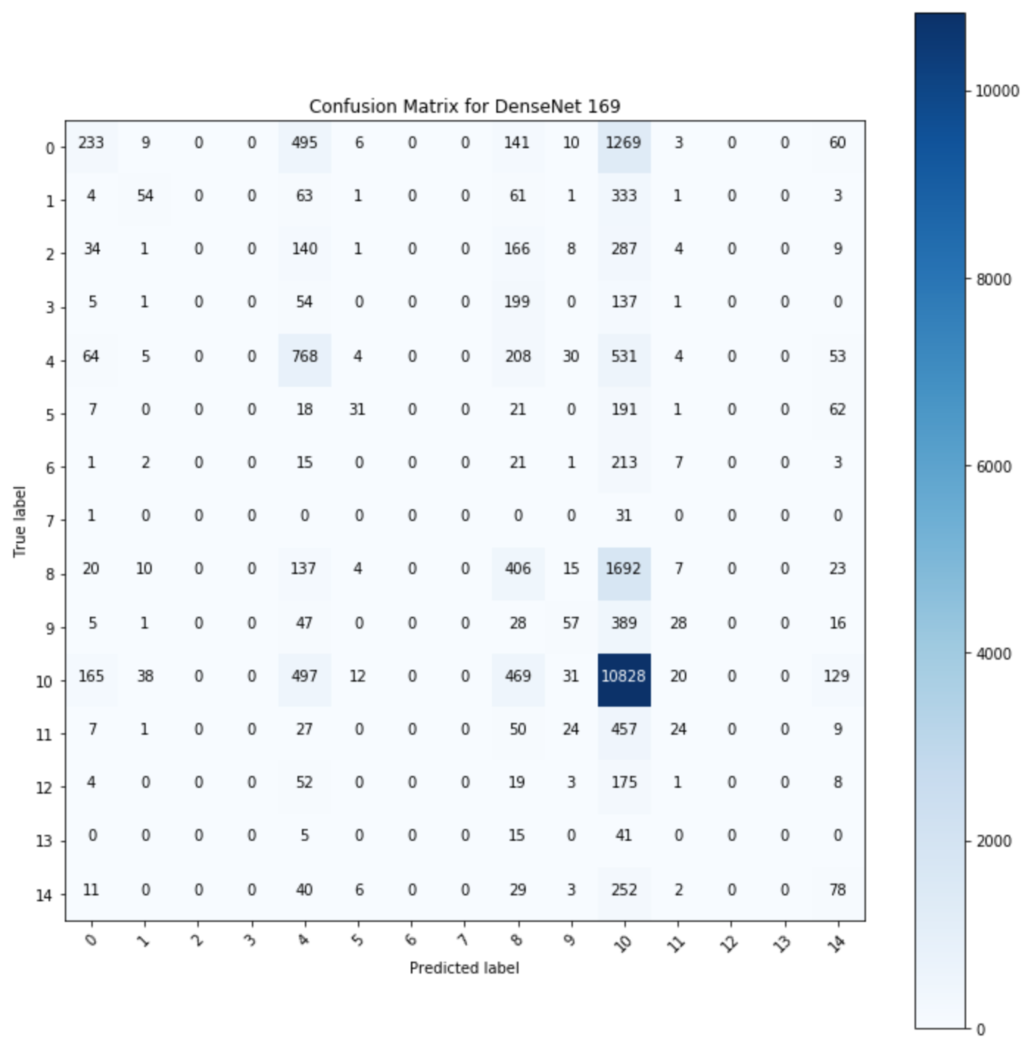
Multi-label Classification Result (15 Classes)
The model classified most images to 4 dominant classes (‘Atelectasis’, 'Effusion', 'Infiltration', 'No Finding'). Images from 6 under-represented classes were completely ignored (all zero)

Slide 24
How to Alleviate Dataset Imbalance
Tackle From Source
Assign Weights
Resample the dataset
Oversample under-represent classes and desample dominated classes.
Advantage: adding data
Assign class weight
Assign class weights to weight the loss function during training, which tells the model to “pay more attention” to samples from an under-represented class.
Advantage: faster and easier

Slide 25
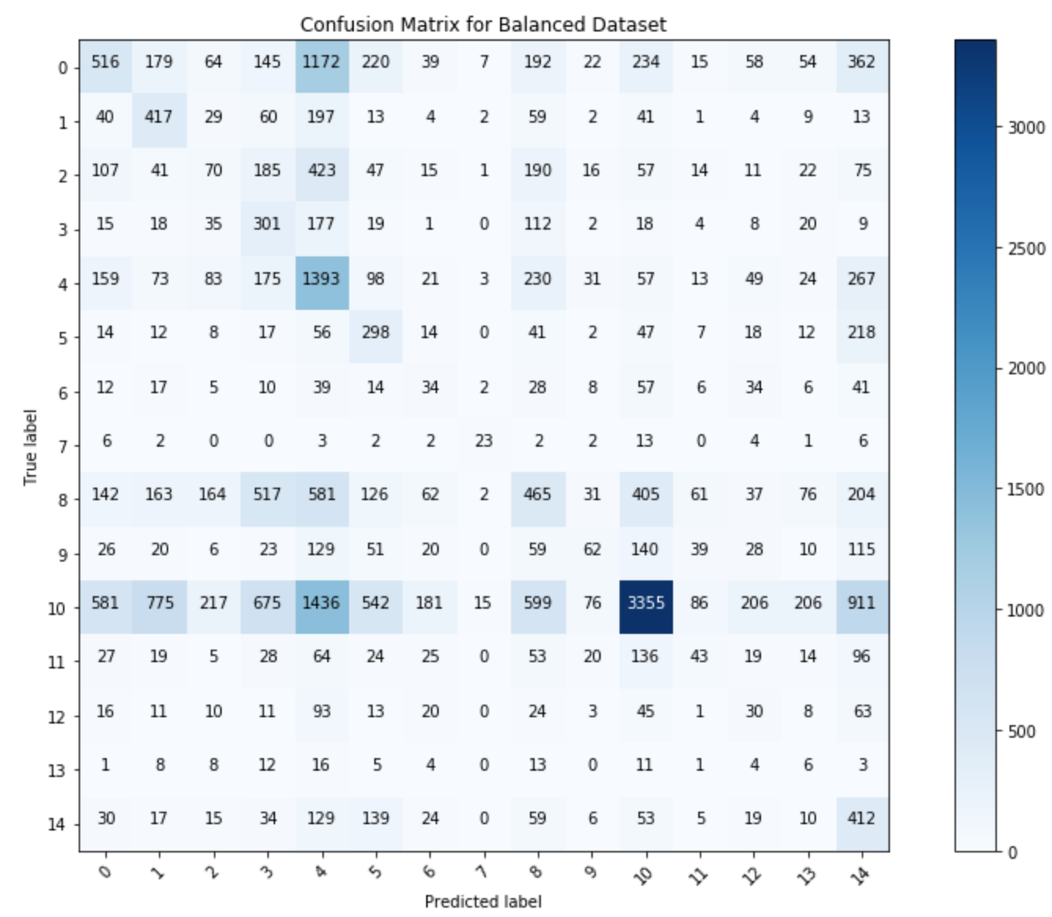
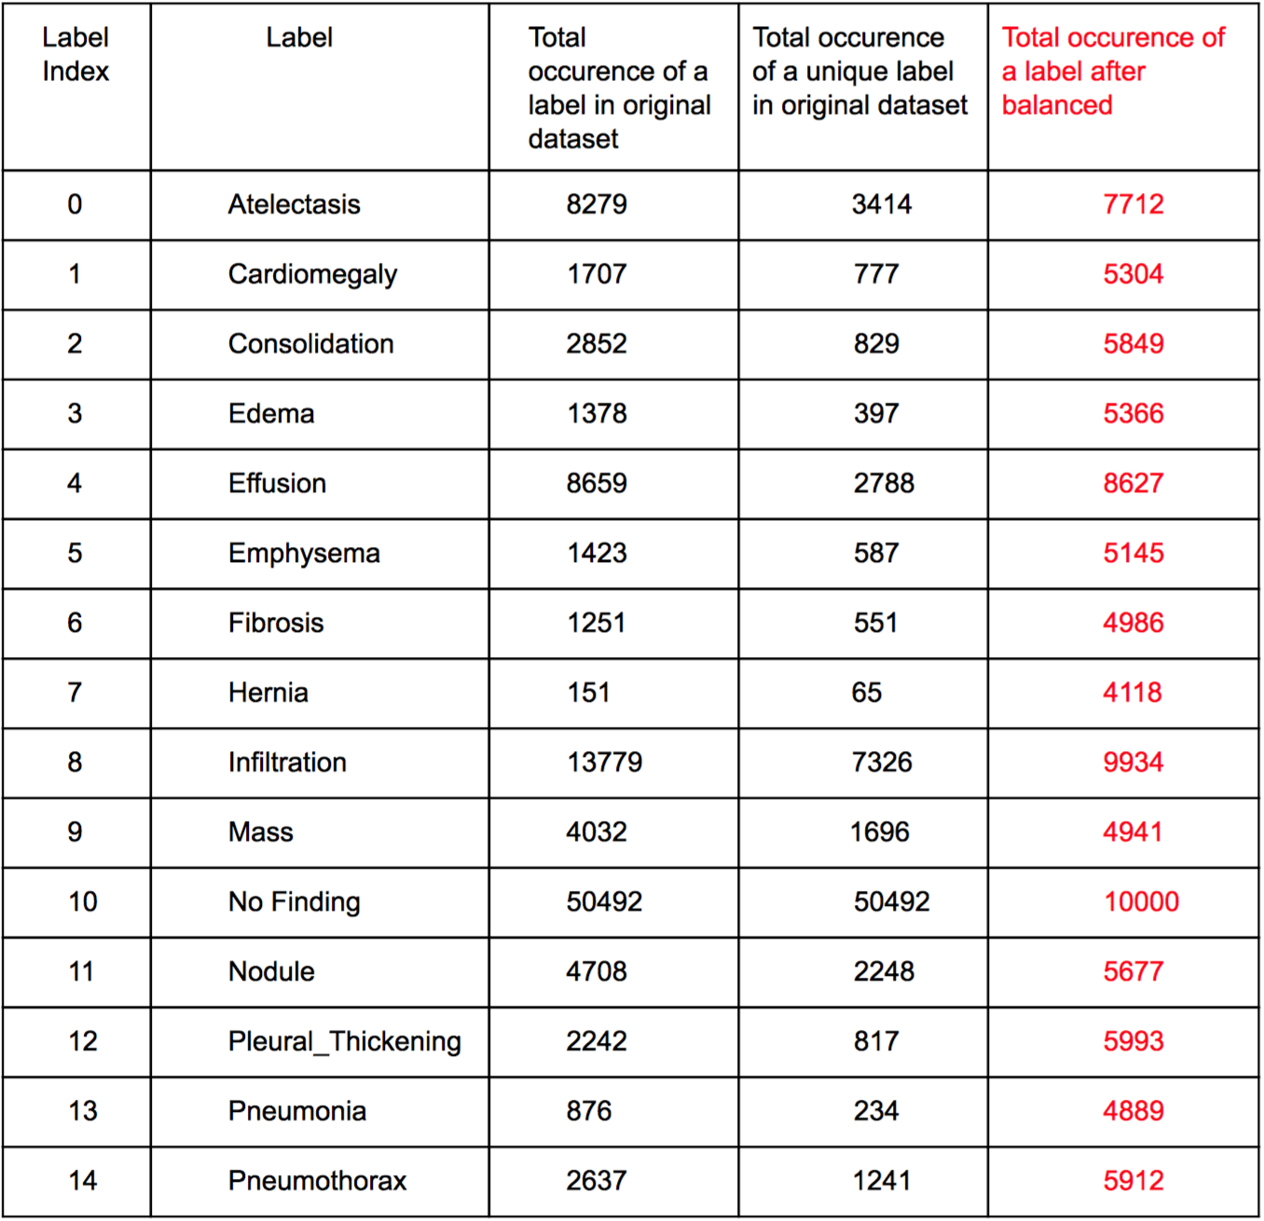
Resampling dataset

Slide 26
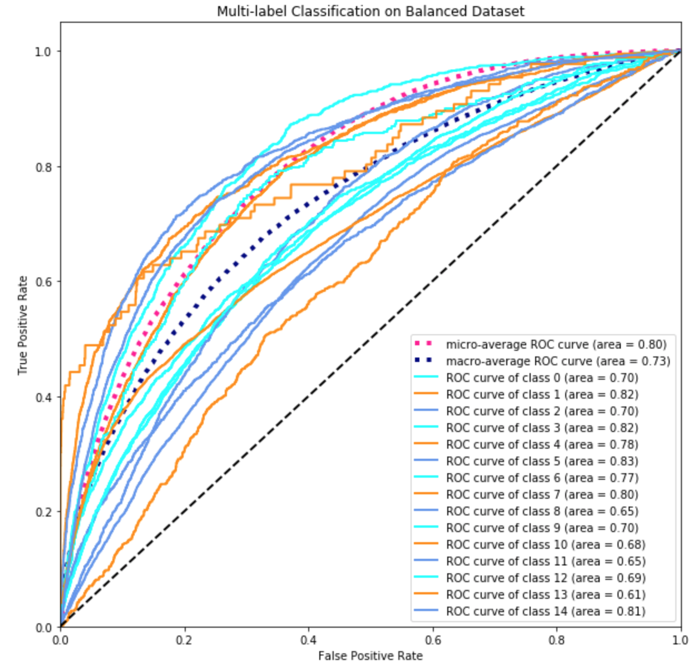
Resampling dataset
After Resampling:
Before Resampling:

Slide 27
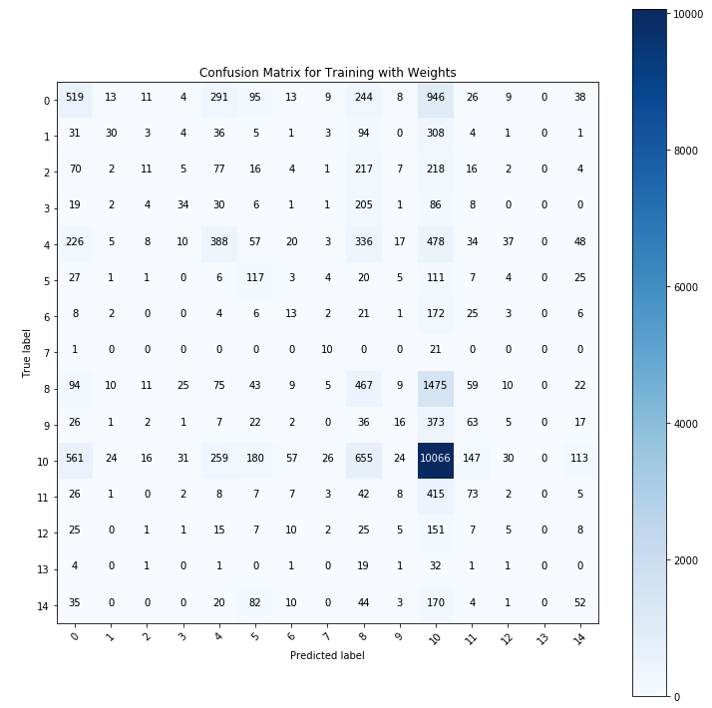
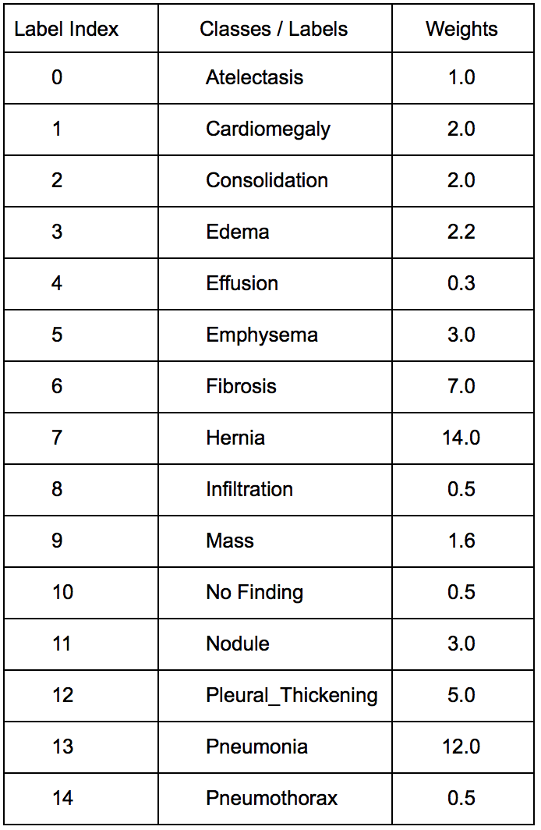
Assign Weights

Slide 28
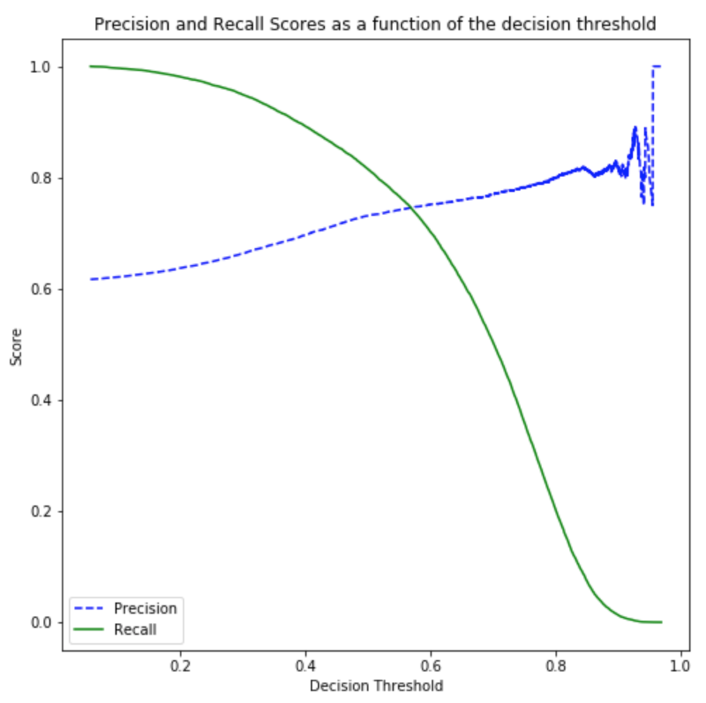
Binary Classification Result
With the threshold 0.58, we got the confusion matrix:
 | Pred_neg | Pred_pos
Neg | 6074 | 3787
Pos | 4459 | 11272
The confusion matrix yield the following evaluation metrics:
Accuracy | Precision | Recall | F1-score | AUROC
0.6784 | 0.7340 | 0.7477 | 0.7408 | 0.70
The best accuracy was about 69.3%.

Slide 29
Binary Classification on Resampled Dataset
With the threshold 0.58, we got the confusion matrix:
 | Pred_neg | Pred_pos
Neg | 5694 | 4167
Pos | 3988 | 11743
 | Test Dataset | Train Dataset | Balanced Train Dataset
No-Finding | 9861 | 50492 | 36020
Disease(s) | 15731 | 36020 | 36020
The confusion matrix yield the following evaluation metrics:
Accuracy | Precision | Recall | F1-score | AUROC
0.6813 | 0.7381 | 0.7465 | 0.7423 | 0.70
After testing with multiple threshold, the best accuracy was about 69.77%.

Slide 30
Classification on Disease Only
Drop samples in the ‘No Finding’ class for both train and test dataset.
32400 train data, 3620 validation data and 15731 test data (with proportion about 9:1:4).

Slide 31
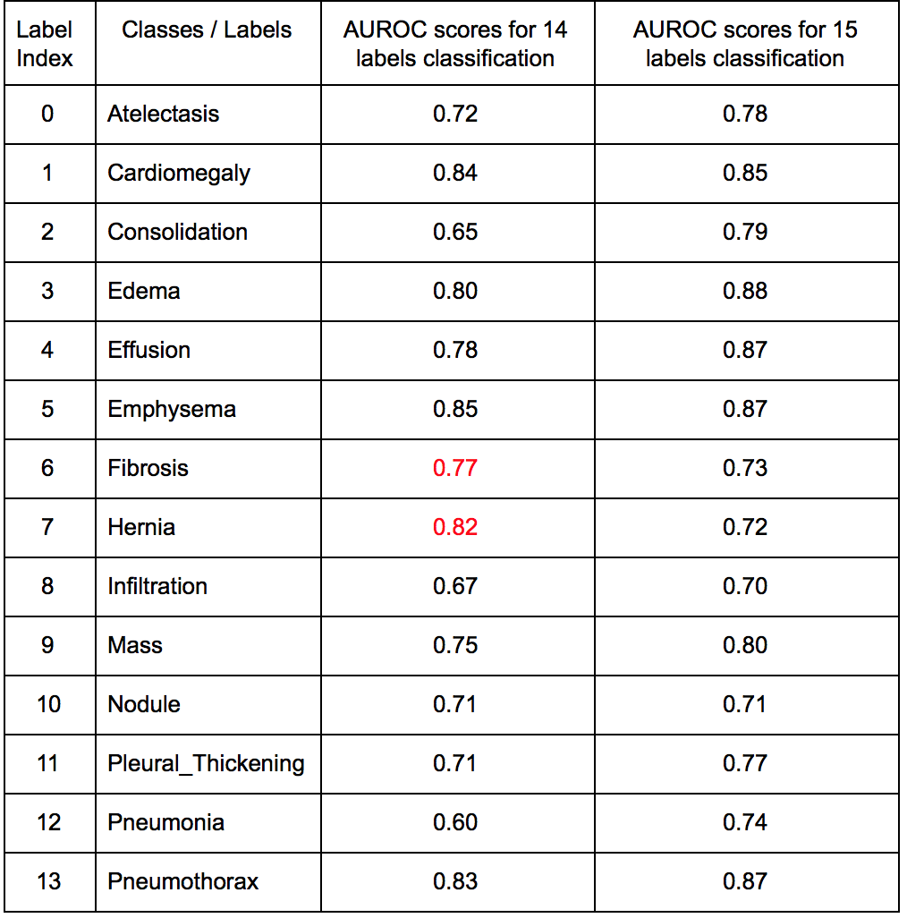
Result & Thought
The 14 labels classification model was relatively more sensitive to small classes.
The existence of the ‘No Finding’ class boosted the AUROC scores.

Slide 32
Limitation
For multi-label classification, the model could not classify under-represented classes very well, despite high AUROC scores.
Poor generalization ability.
Ignore label dependency.

Slide 33
Conclusion
Oversampling will improve AUROC scores, especially for under-represent classes.
Our preprocessing way (crop, remove blacklist and enlarge images) is proven to improve classification result.
Add ReLU layers yield better classification result.
SGD is a better optimizer to find minimum value.
Build multiple binary classification models could give better AUROC scores.

Slide 34
Q & A

Slide 35
THE END
Special thanks to Akshay and Krishnan

